Slide 1
Applied Machine Learning SEZG568/SSZG568
Dr Y V K RAVI KUMAR
yvk.ravikumar@pilani.bits-pilani.ac.in

Slide 2
Session 1(22nd July 2023)

Slide 3
Syllabus - Handout
No | Title of the Module | References
M1 | Introduction to Machine Learning What and Why Applications of Machine Learning Types of Machine Learning Challenges in Machine Learning | T1: Chapter 1 R2
M2 | Big Picture: End-to-end Machine Learning 2.1. Framing the ML Problem 2.2. Data Types, Pre-processing, Visualization and Analysis | T1: Chapter 2 T2: Chapter 2-3
M3 | Big Picture: End-to-end Machine Learning 3.1 Model Selection and Training 3.1.1. Prediction Problem 3.1.2. Classification Problem 3.2 Evaluation 3.2.1. Prediction Problem 3.2.2. Classification Problem 3.3 Machine Learning Pipeline | T1: Chapter 2-3 T2: Chapter 4
M4 | Linear Prediction Models Linear Regression Gradient Descent and Variants Regularization Bias Vs. Variance | T1: Chapter 4 T2: Appendix D

Slide 4
Syllabus - Handout
M5 | Classification Models I Logistic Regression Support Vector Machines Naïve Bayes Comparative Analysis | T1: Chapter 4, 5 T2: Chapter 5
M6 | Classification Models II Decision Tree Challenges with Decision tree Ensembles 6.2.1. Bagging 6.2.2. Boosting Random Forest | T1: Chapter 6-7 T2: Chapter 4, 5
M7 | Unsupervised Learning 7.1. Dimensionality reduction and feature extraction 7.2 K-means Clustering 7.4 EM Algorithm 7.5 Applications | T1: Chapter 8-9 T2: Chapter 8-9
M8 | Neural Networks 8.1. Perceptrons and Delta Rule 8.2. Multi-Layer Perceptrons and Backpropagation 8.3. Deep Learning | T1: Chapter 10-11 T2: Chapter 5
M9 | Deep Networks 9.1. Convolutional Neural Network 9.2. Recurrent Neural Network 9.3. Applications in Image and Text Processing | T1: Chapter 14, 15
M10 | FAccT Machine Learning 10.1. Bias and Fairness 10.2. Interpretability and Transparency 10.3. Robustness and Adversarial Attacks | R1

Slide 5
Treasure Hunt
Text Book(s)
T1 | Aurelien Geron, “Hands-On Machine Learning with Scikit-Learn, Keras and Tensorflow”, O’Reilly, 2020
T2 | P-N Tan, M. Steinbach, Vipin Kumar, “Introduction to Data Mining”, 2016, Pearson
Reference Book(s) & other resources
R1 | Christoph Molner, “Interpretable Machine Learning”, 2020, https://christophm.github.io/interpretable-ml-book/
R2 | Pedro Domingos, “A Few Useful Things to Know About Machine Learning”,pp.78-87, Communications of the ACM, vol. 55 no. 10, October 2012.

Slide 6
Session 1 – 22nd July 2023
1 | Introduction to Machine Learning: What and Why, Applications of Machine Learning, Types of Machine Learning, Challenges in Machine Learning | T1: Chapter 1

Slide 7
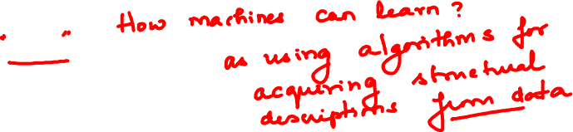
In this segment
What is Machine Learning
Why Machine Learning
Connection with Other technical areas

Slide 8
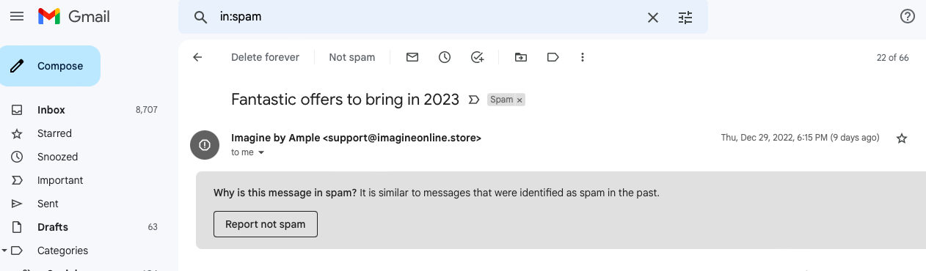
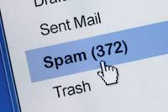
What is Machine Learning?

Slide 9
What is Machine Learning?
Machine learning “ Field of Study that gives the computers the ability to learn without being explicitly programmed”
---- Arthur Samuel (1959)

Slide 10
What is Machine Learning?
Input (X) | Output(Y) | Application
email | Spam(0/1) | Spam filtering
English | Hindi | Machine translation
audio | Text transcripts | Speech recognition
Medical Images | Tumour(0/1) | Visual inspection
Image, radar info | Position of cars | Self-driving car

Slide 11
What is Machine Learning (ML)?
What is Machine Learning
The science (and art) of programming computers so they can learn from data
More general definition
Field of study that gives computers the ability to learn without being explicitly programmed
Engineering-oriented definition
Algorithms that improve their performance P at some task T with experience E
A well-defined learning task is given by <P, T, E>
Traditional programming
Machine Learning
Computer
Data
Output
Computer
Data
Program
Output
Program

Slide 12
Defining the Learning Tasks
Improve on task T, with respect to performance metric P, based on experience E
Example 1
T: Playing checkers
P: Percentage of games won against an arbitrary opponent
E: Playing practice games against itself
Example 2
T: Recognizing hand-written words
P: Percentage of words correctly classified
E: Database of human-labeled images of handwritten words
Example 3
T: Driving on four-lane highways using vision sensors
P: Average distance traveled before a human-judged error
E: A sequence of images and steering commands recorded while observing a human driver.
Example 4
T: Categorize email messages as spam or legitimate.
P: Percentage of email messages correctly classified.
E: Database of emails, some with human-given labels

Slide 13
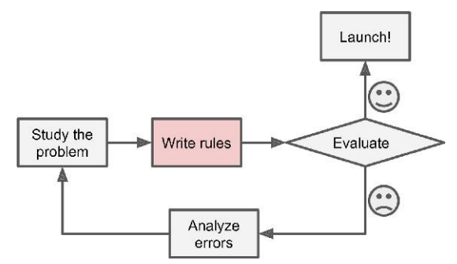
Traditional Approach to Spam Filtering
Spam typically uses words or phrases such as “4U,” “credit card,” “free,” and “amazing”
Solution
Write a detection algorithm for frequently appearing patterns in spams
Test and update the detection rules until it is good enough.
Challenge
Detection algorithm likely to be a long list of complex rules
hard to maintain.

Slide 14
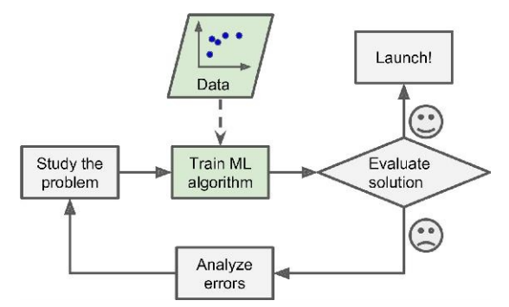
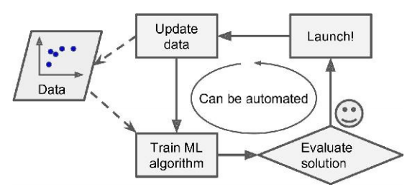
Machine Learning Approach
Automatically learns phrases that are good predictors of spam by detecting unusually frequent patterns of words in spams compared to “ham”s
The program is much shorter, easier to maintain, and most likely more accurate.

Slide 15
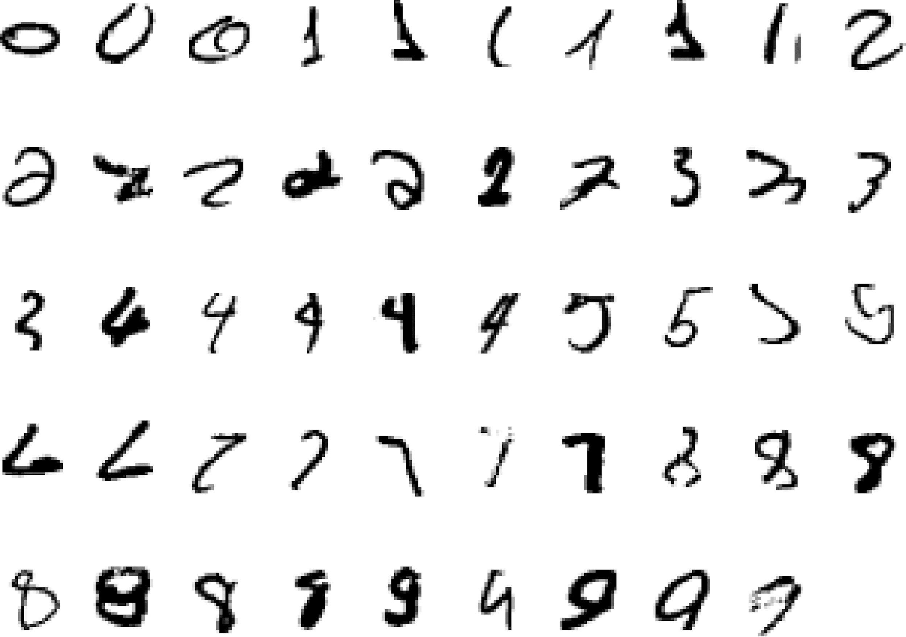
A Classic example of ML Task
It is very hard to say what makes a “2”
Actually a “3” not a “2”
All “2”s
A “3”
A “7”

Slide 16
More ML Usage Scenarios
Tasks that are best solved by using a learning algorithm
Recognizing Patterns in images, text
Facial identities or facial expressions
Handwritten or spoken words
Medical images
Recognizing Anomalies in structured dataset
Unusual credit card transactions
Unusual patterns of sensor readings in a nuclear power plant
Prediction from time series data
Future stock prices or currency exchange rates
Generating new Patterns
Generating images or motion sequences

Slide 17
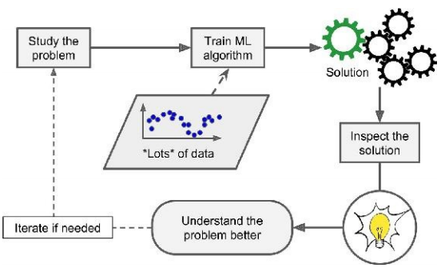
Machine Learning Helps Human Learning
Sometimes reveals unsuspected correlations / new trends leading to better understanding
Data Mining
Applying ML techniques to dig into large amounts of data can help discover patterns

Slide 18

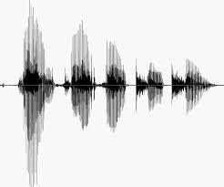
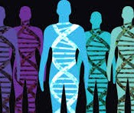
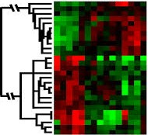
When to Use Machine Learning
ML Usage Scenarios
Problems for which existing solutions require a lot of hand-tuning or long lists of rules
Complex problems for which there is no good solution at all using a traditional approach
Changing environments
Get insights about complex problems and large amounts of data

Slide 19
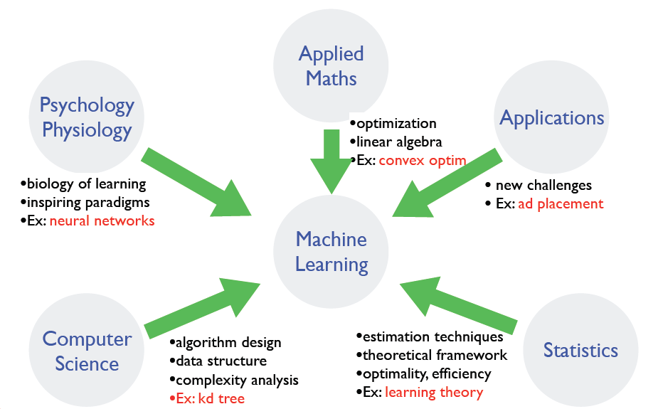
Where does ML fit in?

Slide 20
Application Domains
Internet
Computational biology
Finance
E-commerce
Space exploration
Robotics
Information extraction
Social networks
Software engineering
System management
Creative Arts

Slide 21
Example: Classification
Assign object/event to one of a given finite set of categories
Medical Diagnosis
Credit card applications or transactions
Fraud detection in e-commerce
Worm detection in network packets
Spam filtering in email
Recommended articles in a newspaper
Recommended books, movies, music, or jokes
Financial investments
DNA sequences
Spoken words
Handwritten letters
Astronomical images

Slide 22
Example: Planning, Control, Problem Solving
Performing actions in an environment in order to achieve a goal
Playing checkers, chess, or backgammon
Balancing a pole
Driving a car or a jeep
Flying a plane, helicopter, or rocket
Controlling an elevator
Controlling a character in a video game
Controlling a mobile robot

Slide 23


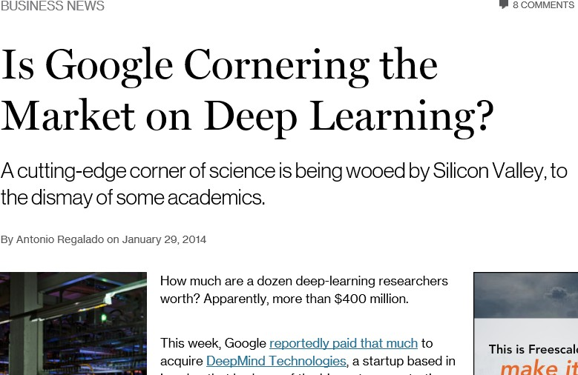
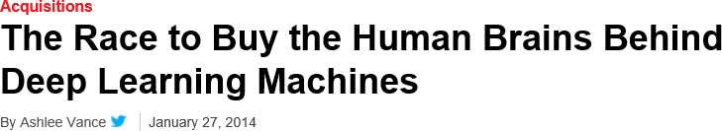
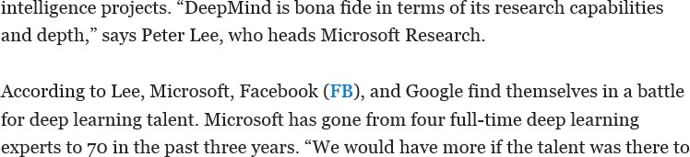
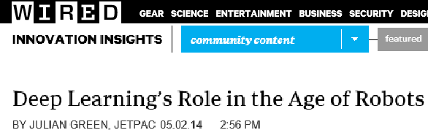
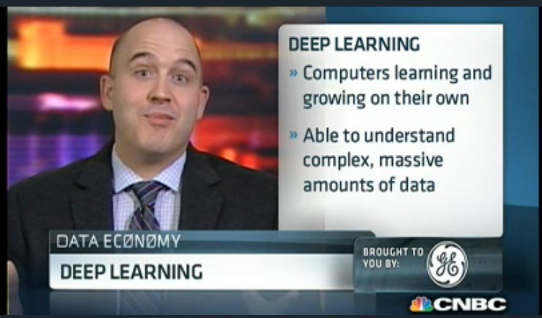
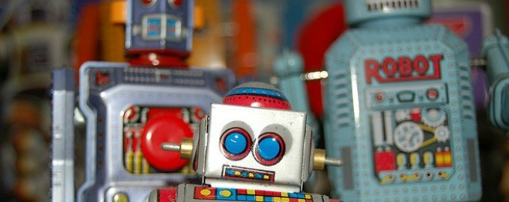
Deep Learning in Headlines

Slide 24
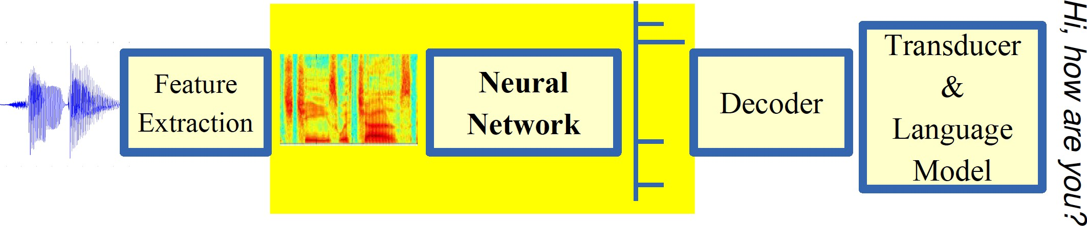
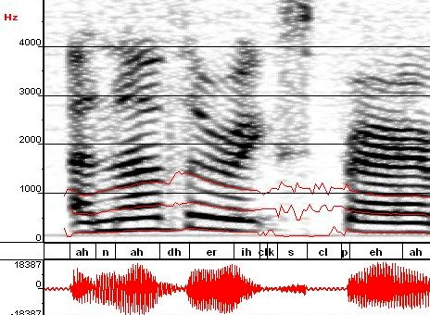
Breakthrough in Automatic Speech Recognition
ML used to predict of phone states from the sound spectrogram
Deep learning has state-of-the-art results
# Hidden Layers | 1 | 2 | 4 | 8 | 10 | 12
Word Error Rate % | 16.0 | 12.8 | 11.4 | 10.9 | 11.0 | 11.1
Baseline (Gaussian Mixture Model) performance = 15.4%
[Reference: Zeiler et al., “On rectified linear units for speech recognition” ICASSP 2013]

Slide 25
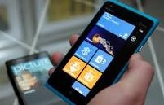
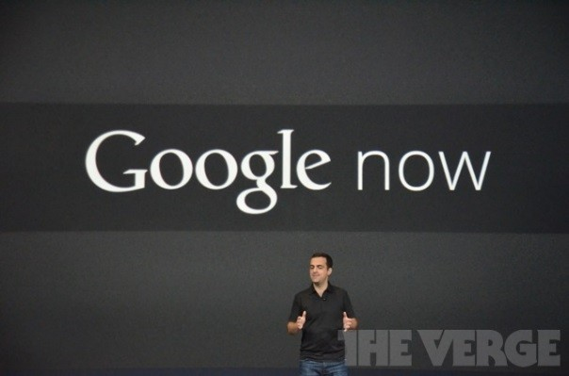
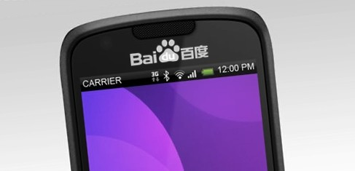
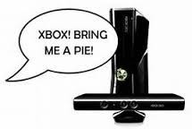



Impact of Deep Learning in Speech Technology

Slide 26
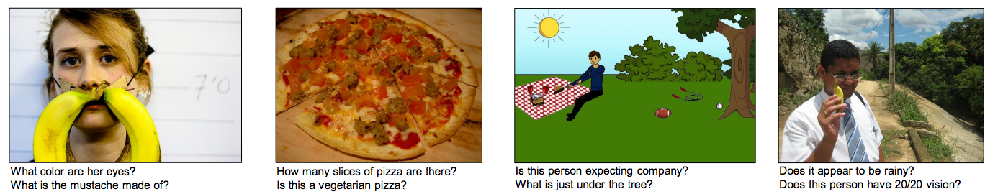
Visual Question Answering
Answering questions about images

Slide 27
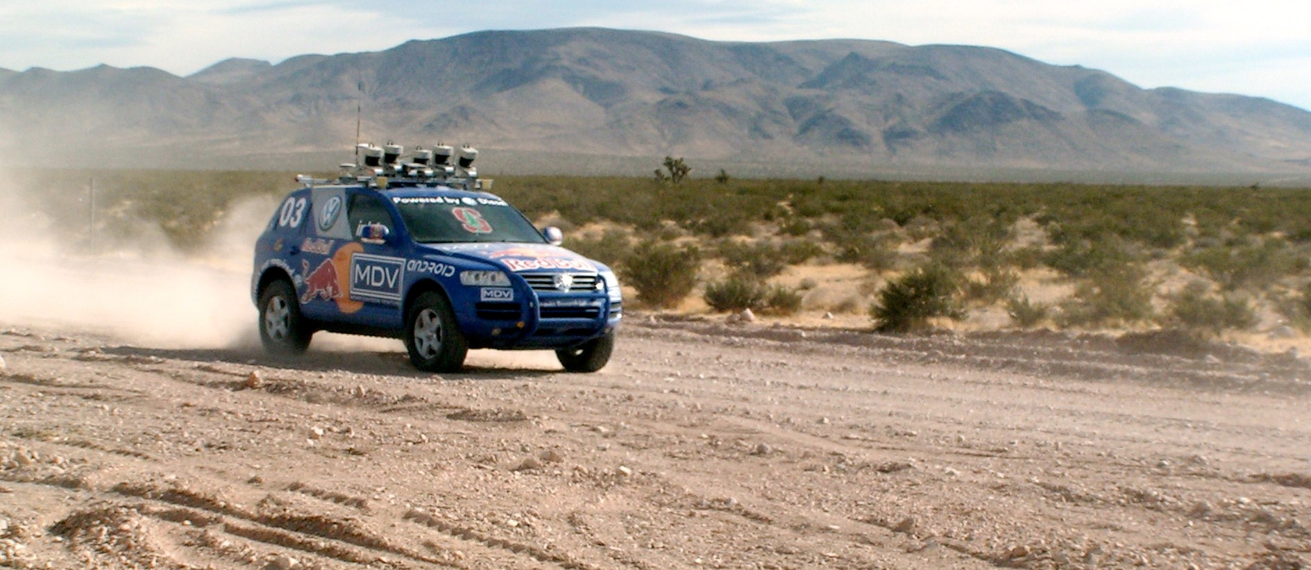
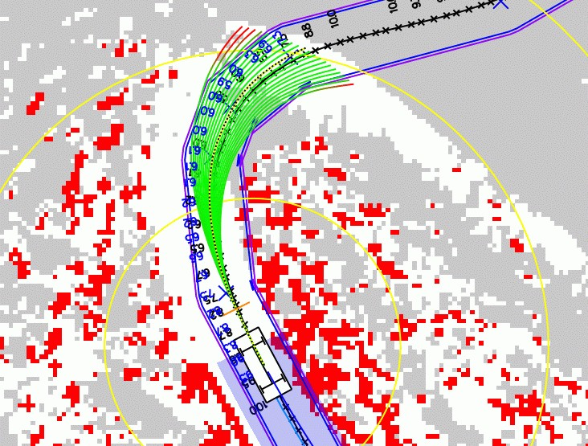
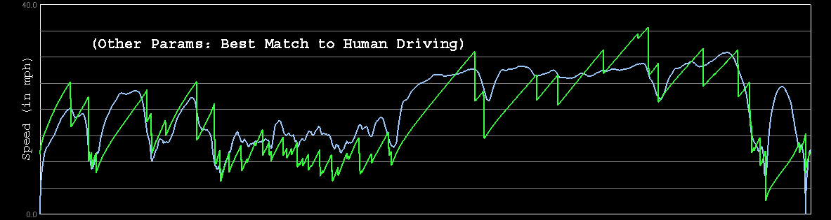

Autonomous Car Technology
Path Planning
Laser Terrain Mapping
Learning from Human Drivers
Sebastian
Adaptive Vision
Stanley

Slide 28
Contemporary ML Based Solutions
Optical Character Recognition
Product Image Classification on a production line
Detecting tumors in brain scans
Information extraction from document images
Categorization of news articles
Flagging offensive comments in discussion forums
Document summarization
Forecasting company revenue
Chatbots / Voice activated App
Detecting Credit Card Fraud
Customer Segmentation
Recommendation System for products, movies, news

Slide 29
Types of Machine Learning Systems
There are so many different types of Machine Learning systems that it is useful to classify them in broad categories based on:
Based on Training :Whether or not they are trained with human supervision (supervised, unsupervised, semisupervised, and Reinforcement Learning)
Based on stream of incoming data: Whether or not they can learn incrementally on the fly (online versus batch learning)
How they generalize: Whether they work by simply comparing new data points to known data points, or instead detect patterns in the training data and build a predictive model, much like scientists do (instance-based versus model-based learning)

Slide 30
ML Terminologies
1.Labels: A label is the thing we're predicting—the y variable in simple linear regression. The label could be the future price of gold, the kind of animal shown in a picture, the meaning of an audio clip.
2. Features/attribute: A feature is an input variable—the x variable in simple linear regression. A simple machine learning project might use a single feature, while a more sophisticated machine learning project could use millions of features, specified as:
x1, x2,……..xn
In the spam detector example, the features could include the following:
words in the email text
sender's address
time of day the email was sent
Another example: To predict the price (label) of used car , using the features,
1. mileage
2. age
3.brand

Slide 31
ML Terminologies
3.Examples/Instances
An example is a particular instance of data, x. (We put x in boldface to indicate that it is a vector.) We break examples into two categories:
labeled examples
unlabeled examples
A labeled example includes both feature(s) and the label. That is:
labeled examples: {features, label}: (x, y)
An unlabeled example contains features but not the label. That is:
unlabeled examples: {features, ?}: (x, ?)

Slide 32
ML Terminologies
4. Models
A model defines the relationship between features and label. For example, a spam detection model might associate certain features strongly with "spam". Let's highlight two phases of a model's life:
Training means creating or learning the model. That is, you show the model labeled examples and enable the model to gradually learn the relationships between features and label.
Inference means applying the trained model to unlabeled examples. That is, you use the trained model to make useful predictions (y'). For example, during inference, you can predict HouseValue for new unlabeled examples.

Slide 33
Types of Learning
Based on level of supervision
Supervised (inductive) learning
Given: training data, desired outputs (labels)
Unsupervised learning
Given: training data only (without desired outputs)
Semi-supervised learning
Given: training data and a few desired outputs
Reinforcement learning
Given: rewards from sequence of actions

Slide 34
Types of Learning : Supervised Learning
Based on level of supervision
Regression vs. classification
A regression model predicts continuous values. For example, regression models make predictions that answer questions like the following:
What is the value of a house in Bangalore?
What is the probability that a user will click on this ad?
A classification model predicts discrete values. For example, classification models make predictions that answer questions like the following:
Is a given email message spam or not spam?
Is this an image of a dog, a cat, or a hamster?

Slide 35




Supervised Learning: Regression
Given (x₁, y₁), (x₂, y₂), ..., (x_{n}, y_{n})
Learn a function f (x) to predict y given x
– y is real-valued
9
8
7
6
5
4
3
2
1
0
1970 1980
September Arctic Sea Ice Extent (1,000,000 sq km)
1990
2000
2010
2020
Year Number

Slide 36










Supervised Learning: Classification
Given (x₁, y₁), (x₂, y₂), ..., (x_{n}, y_{n})
Learn a function f (x) to predict y given x
– y is categorical
Cancer (benign / malignant)
y=1 (malignant)
y=0 (benign)
Tumor Size (x)

Slide 37








Supervised Learning: Classification
Given (x₁, y₁), (x₂, y₂), ..., (x_{n}, y_{n})
Learn a function f (x) to predict y given x
– y is categorical
Cancer (benign / malignant)
1 (malignant)
0 (benign)
Tumor Size
Learnt classifer
If x>T, malignant else benign
Predict benign
Predict malignant
x=T

Slide 38










Increasing Feature Dimension
x can be multi-dimensional
– Each dimension corresponds to an attribute
Clump Thickness
Uniformity of Cell Size
Uniformity of Cell Shape
…
Age
Tumor Size

Slide 39
Example: Supervised Learning Techniques
Linear Regression
Logistic Regression
Naïve Bayes Classifiers
Support Vector Machines (SVMs)
Decision Trees and Random Forests
Neural networks

Slide 40















Unsupervised Learning
Given x₁, x₂, ..., x_{n} (without labels)
Output hidden structure behind the x’s
e.g., clustering

Slide 41
Example: Unsupervised Learning Techniques
Clustering
k-Means
Hierarchical Cluster Analysis
Expectation Maximization
Visualization and dimensionality reduction
Principal Component Analysis (PCA)
Kernel PCA
Locally-Linear Embedding (LLE)
t-distributed Stochastic Neighbor Embedding (t-SNE)
Association rule learning
Apriori
Eclat

Slide 42
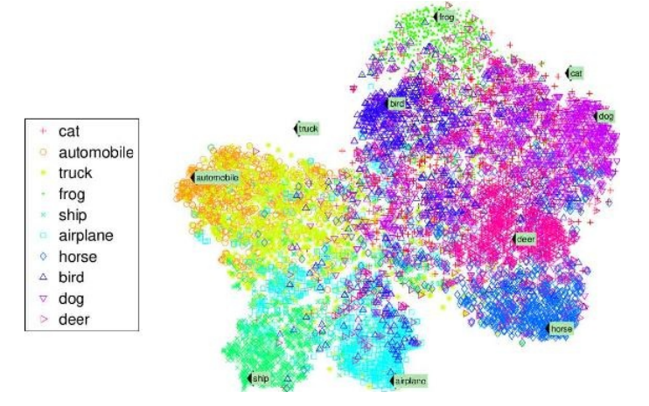
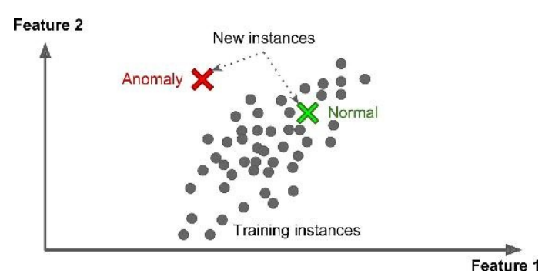
Data Visualization
Visualize 2/3D representation of complex unlabelled training data
Preserve as much structure as possible
e.g., trying to keep separate clusters in the input space from overlapping in the visualization
Understand how the data is organized
Identify unsuspected patterns.
frog
cat
bird
dog
truck
automobile
deer
horse
ship
airplane

Slide 43
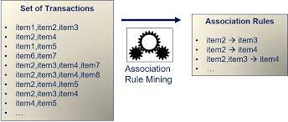
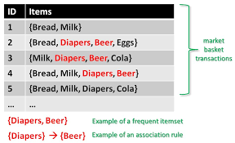
Association Rule Mining

Slide 44
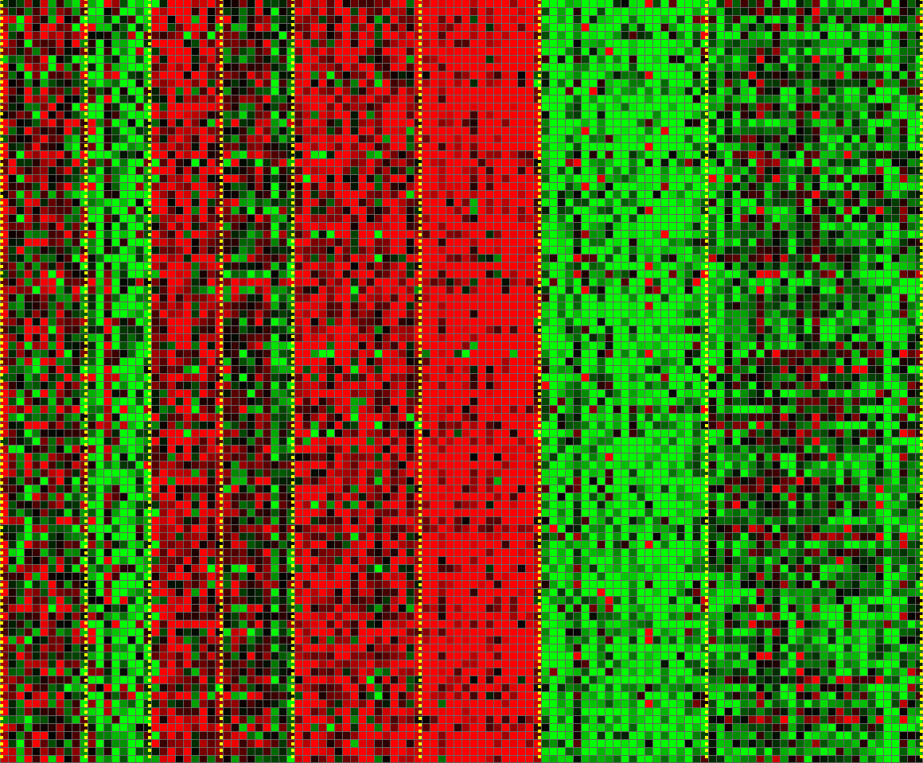
Applications: Unsupervised Learning
Genomics application: Group individuals by genetic similarity
Genes
Individuals

Slide 45
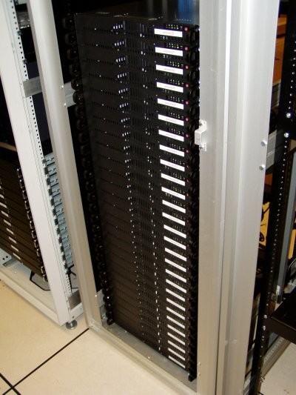
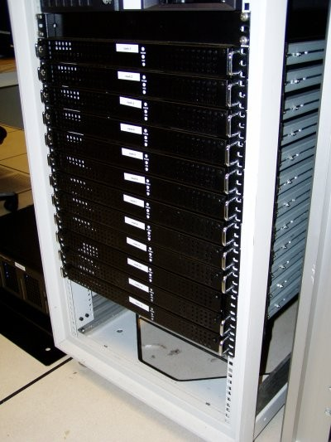




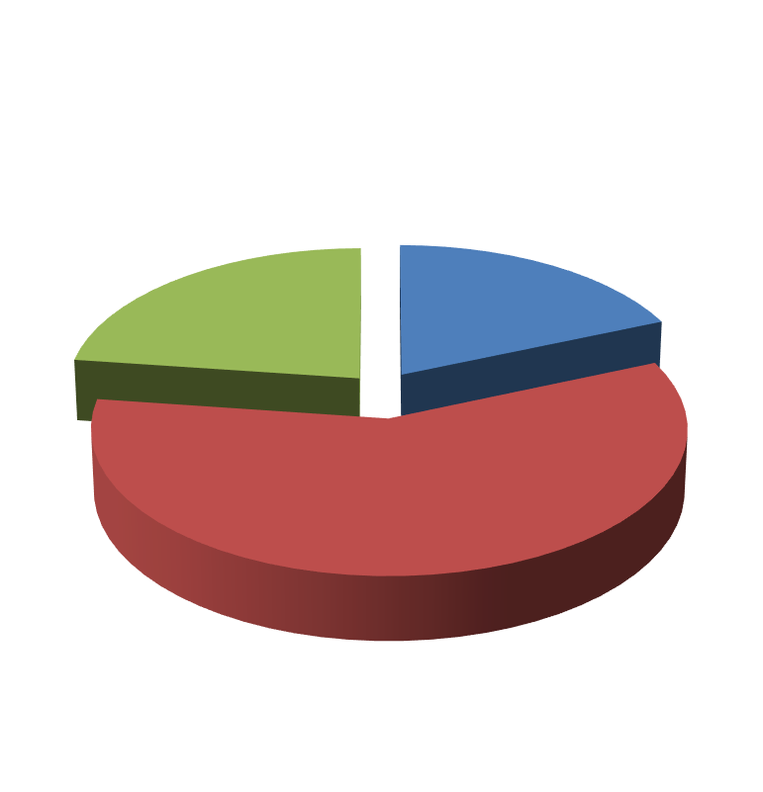
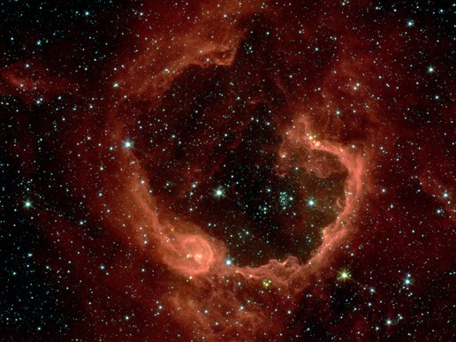



Applications: Unsupervised Learning
Organize computing clusters
Social network analysis
Market segmentation
Astronomical data analysis

Slide 46
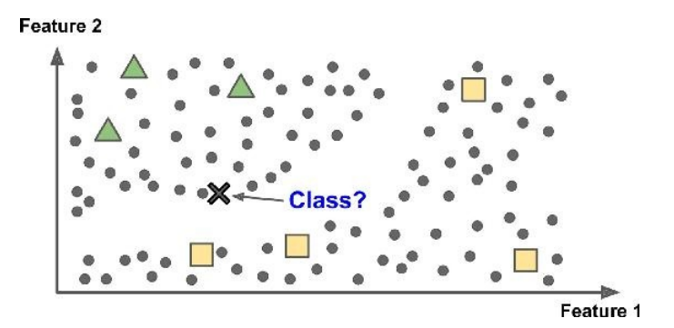
Semisupervised Learning
Partially labelled data – few labelled data and a lot of unlabelled data
Combines unsupervised and supervised learning algorithms
Photo hosting service, e.g., google photos

Slide 47
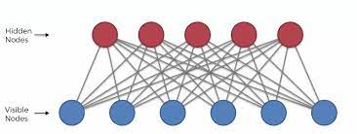
Semisupervised Learning Techniques
Most semisupervised learning algorithms are combinations of unsupervised and supervised algorithms.
For example, deep belief networks (DBNs) are based on unsupervised components called restricted Boltzmann machines (RBMs) stacked on top of one another. RBMs are trained sequentially in an unsupervised manner, and then the whole system is fine-tuned using supervised learning techniques.

Slide 48
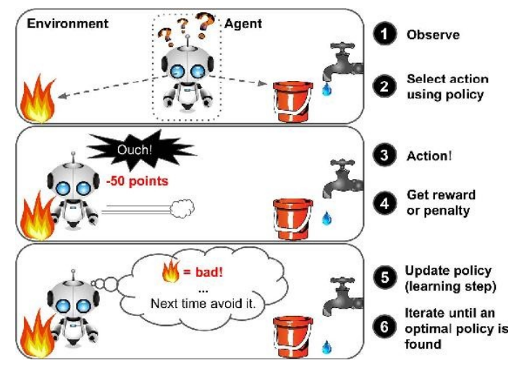
Reinforcement Learning
A learning agent
observes the state of the environment, select and perform actions
gets +ve or -ve rewards in return
learns the best strategy, aka a policy, to get the most reward over time.
policy is a mapping from states → actions
Examples:
Game playing, e.g., AlphaGo
Robot in a maze
Balance a pole on your hand

Slide 49
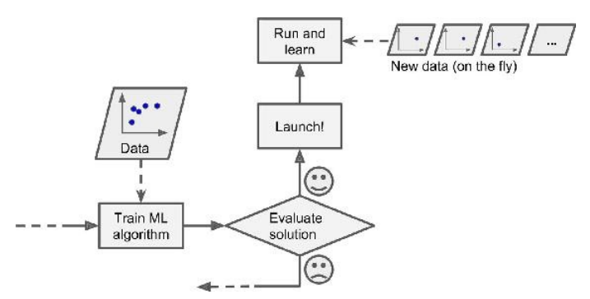
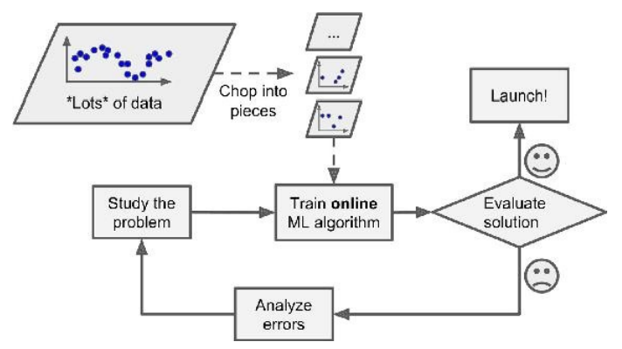
Types of Learning
Based on how training data is used
Batch learning
Uses all available data at a time during training
Mini Batch learning
Uses a subset of available at a time during training
Online (incremental) learning
Uses single training data instance at a time during training

Slide 50
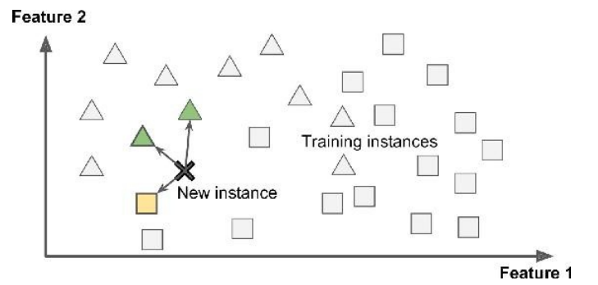
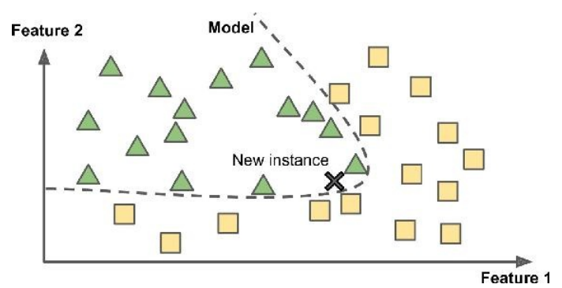
Types of Learning
Based on how training data is used
Instance Based Learning
compare new data points to known data points
Model Based learning
detect patterns in the training data and build a predictive model
Instance Based
Model Based

Slide 51
Challenges of ML
Training Data
Insufficient
Non representative
Poor Quality
Irrelevant attributes
Model Selection
Overfitting
Underfitting
Testing and Validation
Hyperparameters

Slide 52
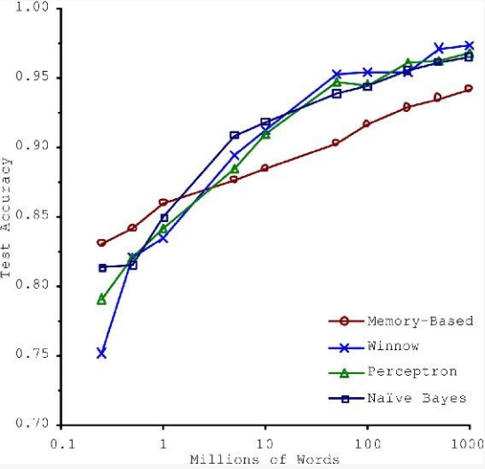
Insufficient Training Data
Consider trade-off Between Algorithm development & training data capture

Slide 53
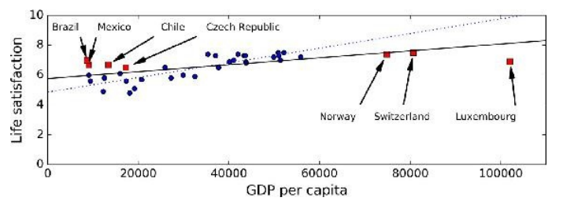
Non-representative Training Data
Training Data be representative of the new cases we want to generalize
Small sample size leads to sampling noise
Missing data over emphasizes the role of wealth on happiness
If sampling process is flawed, even large sample size can lead to sampling bias
missing data
available data

Slide 54
Data Quality
Cleaning often needed for improving data quality
Some instances have missing features
e.g., 5% of customers did not specify their age
Ignore the instances all together or the feature,
fill in the missing values
Train multiple ML models
Some instances can be erroneous, noisy or outliers
Human or machine generated
Identify, discard or fix manually, as appropriate

Slide 55
Irrelevant Features
Feature engineering needed for coming up with a good set of features
Feature selection
more useful features to train on among existing features.
Feature extraction
combine existing features to produce a more useful one.
Create new features by gathering new data

Slide 56
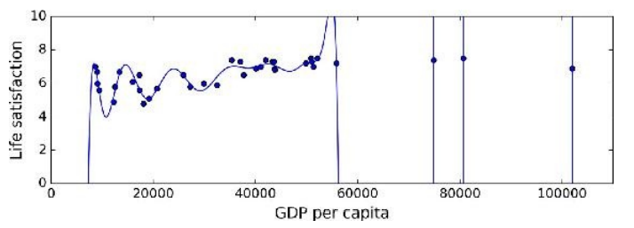
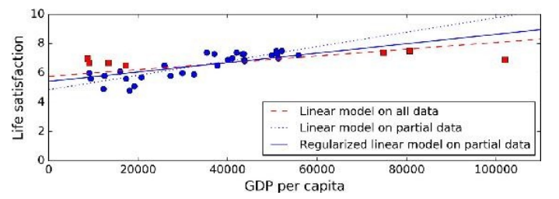
Model Selection
Overfitting or Underfitting
Overfitting leads to high performance in training set but performs poorly on new data
e.g., a high-degree polynomial life satisfaction model that strongly overfits the training data
Small training set or sampling noise can lead to model following the noise than the underlying pattern in the dataset
Solution: Regularization
Underfitting when the model is too simple to learn the underlying structure in the data
Select a more powerful model, with more parameters
Feed better features to the learning algorithm
Reduce regularization
Large slope
Smaller slope
High-order
polynomial

Slide 57
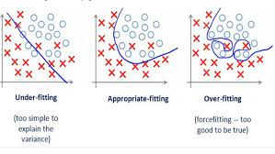
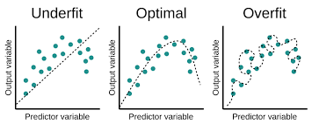
Model Selection
Overfitting or Underfitting

Slide 58
Testing and Validation
Performance of ML algorithms is statistical / predictive
Good ML algorithms need to work well on test data
But test data is often not accessible to the provider of the algorithm
Common assumption is training data is representative of test data
Randomly chosen subset of the training data is held out as validation set
aka dev set
Once ML model is trained, its performance is evaluated on validation data
Expectation is ML model working well on validation set will work well on unknown test data
Typically 20-30% of the data is randomly held out as validation data

Slide 59
Cross Validation
K-fold validation is often performed
To reduce the bias of validation set selection process
Often K is chosen as 10
aka 10 fold cross validation
10 fold cross validation involves
randomly selecting the validation set 10 times
model generation with 10 resulting training set
Evaluate the performance of each on that validation set
averaging the performance over the validation sets

Slide 60
Choice of Hyper parameters
Modern ML models often use a lot of model parameters
Known as hyper parameters
Model performance depends on choice of parameters
Each parameter can assume a number of values
Real numbers or categories
Exponential number of hyper parameter combinations possible
Best model correspond to best cross validation performance over the set of hyper parameter combinations
Expensive to perform
Some empirical frameworks available for hyper parameter optimization

Slide 61
Testing and Validation
x can be multi-dimensional
Each dimension corresponds to an attribute
Clump Thickness
Uniformity of Cell Size
Uniformity of Cell Shape
…
Age
Tumor Size

Slide 62
Thank You!

